Slide 1

University Data Analysis
Presented By: Jurgen Tan

Slide 2
URLs
Industry For First Degree:
https://data.gov.sg/dataset/graduates-from-university-first-degree-courses-by-type-of-course
Enrol, Intake & Graduate:
https://data.gov.sg/dataset/intake-enrolment-and-graduates-by-institutions
Employment Rate:
https://data.gov.sg/dataset/graduate-employment-survey-ntu-nus-sit-smu-sutd
Overseas University Graduates: https://data.gov.sg/dataset/data-gov-sg-dataset-resident-uni-grads-15-yrs-and-over-by-field-of-study-country-where-hqa-sex-2015
Notes:
Cost Of Owning A Vehicle is it due to the increasing of license holders and if there are more vehicles on the road, is the HDB increasing the number of parking lots?

Slide 3
Industry Chosen For First Degree Dataset
1993 to 2014
NA due to course not designed yet
Includes Part-Time & Full Time

Slide 4
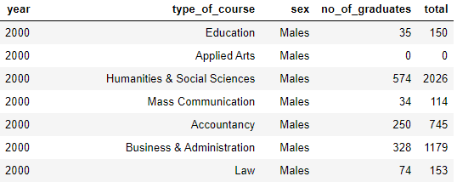
Industry Chosen For First Degree Data Preparation
2000 to 2014
Fill NA values with 0
Sum of Male & Female
Notes:
Bids Received == COE Cost?

Slide 5
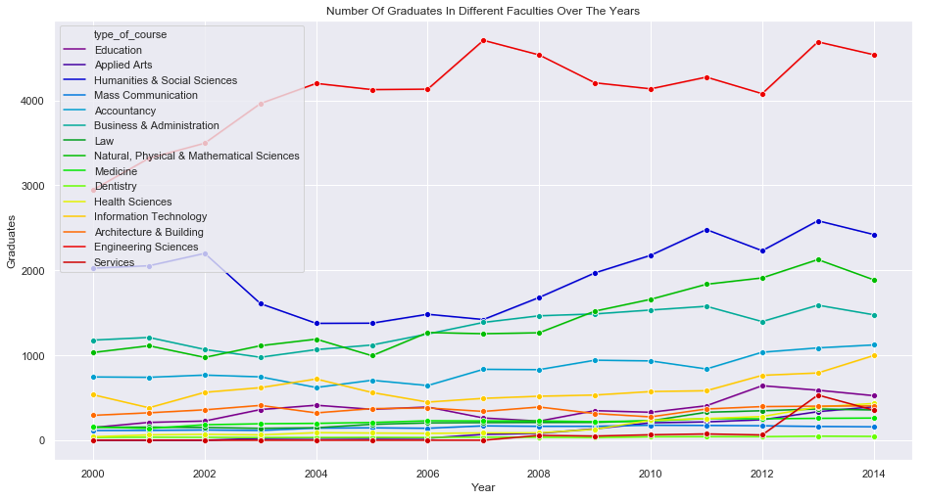
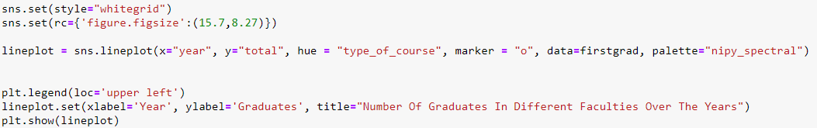
Industry Chosen For First Degree Data Preparation
Science courses have the most graduates
Also the biggest faculties
Notes:
Bids Received == COE Cost?

Slide 6
Enrolment, Intake & Graduation Dataset
3 Datasets
All The Local Tertiaries’ Data
Same Column Names
1982 to 2018

Slide 7


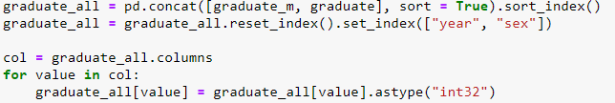
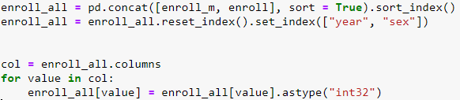
Enrolment, Intake & Graduation Data Preparation
Enroll & Intake: 1982 to 2014
Graduate: 1986 to 2016
Calculating the Male data
Standardizing to “int32”

Slide 8
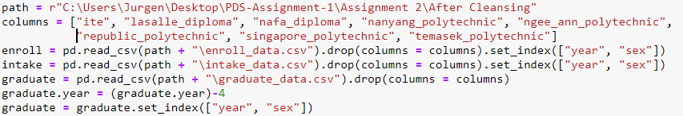

Enrolment, Intake & Graduation Concatenation
3 Datasets
All Local Tertiaries’ Data
Same Column Names
1982 to 2018

Slide 9
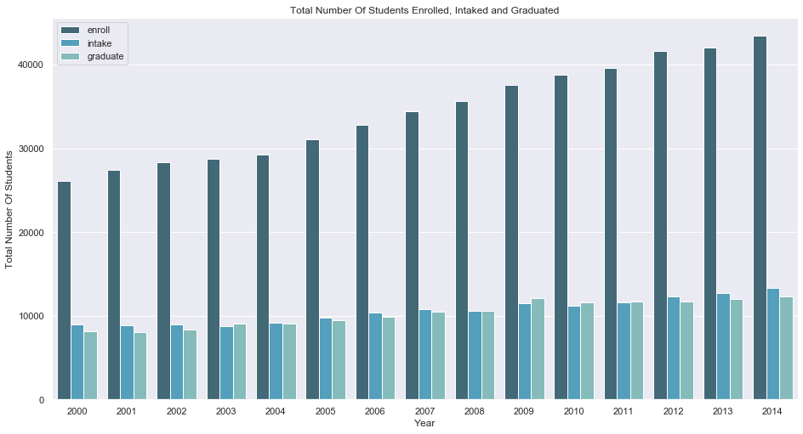
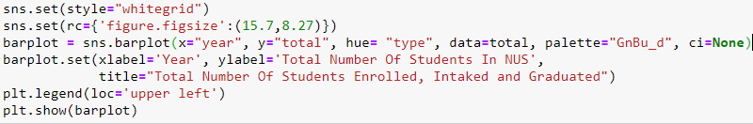
Total Number Of Students Enrolled, Intaked and Graduated
Uprising trend of Enrollment
Marginal increase in Intake
Almost constant difference in Graduation
Notes:
When Is The Best Month To Buy A Car

Slide 10
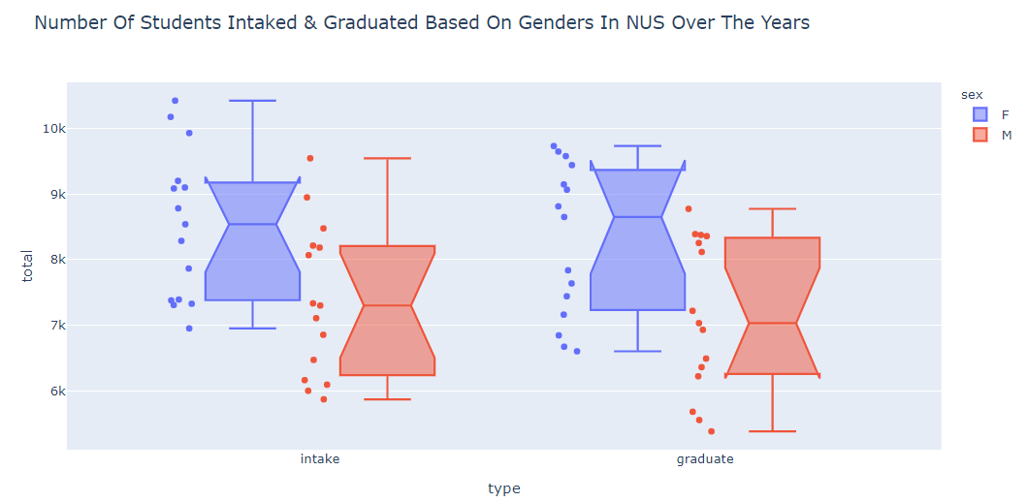
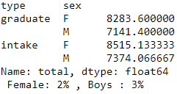
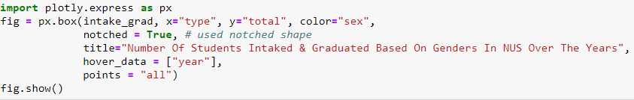
Number Of Students Intaked & Graduated Based On Genders Over The Years
Female > Male
Higher dropout % for Males
Notes:
Price Range For The COE Of Larger Cars

Slide 11
Overseas University Dataset
Categorised by field
In thousands
Full-Time Degrees Only
Only Year 2015

Slide 12
Overseas University Dataset Preparation
Notes:
Bids Received == COE Cost?

Slide 13

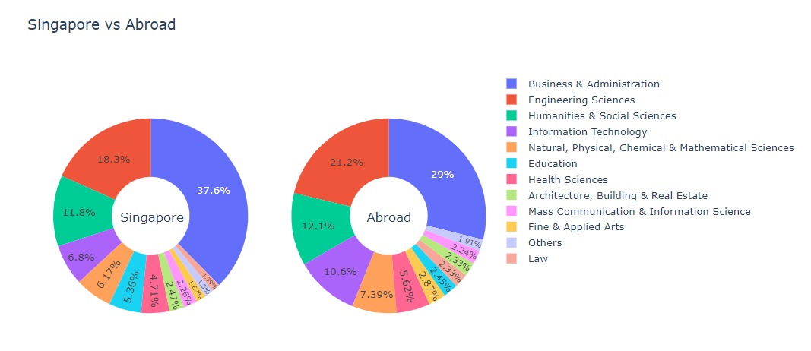
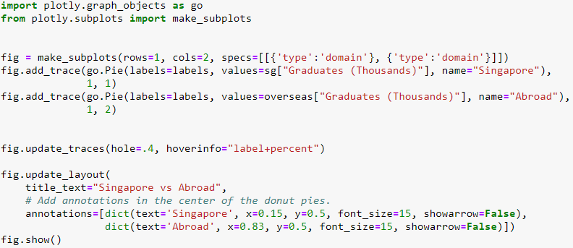
Fields Chosen From Local & Overseas Universities
Negative Gradient, Harsh Decline
2 Outliers
Lower Bids = Higher COE Price
Notes:
Bids Received == COE Cost?

Slide 14
Employment Rate Dataset
2013 to 2017
Employment Rate
Gross & Basic Salary

Slide 15

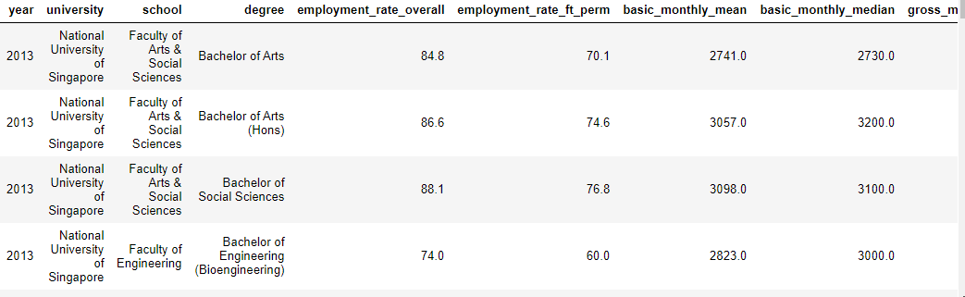
Employment Rate Data Preparation
2013 to 2017
Only NUS
Based on the top 3 fields chosen
Notes:
Bids Received == COE Cost?

Slide 16
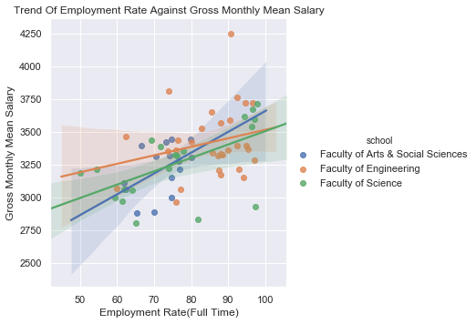
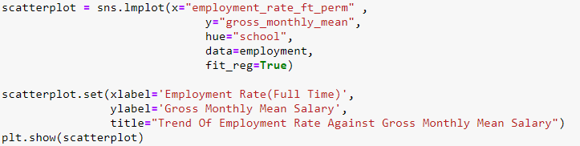
Relationship Between The Employment Rate Against Gross Monthly Mean Salary
The demand for Arts & Social Science is on par with the Mean Salary
The demand for Engineering is high but the Mean Salary is still lower than others
Notes:
Bids Received == COE Cost?

Slide 17
Conclusion
Employment rate is not signified to have a higher salary
Increase the number of intakes in local universities
Bring in more high paying jobs

Slide 18

Thank You

